Slide 1

Natural Language Processing
By Atmanand Gauns

Slide 2
Agenda
Introduction
What NLP consists of
Process for creating ML NLP Models
Techniques used for Training the Models
How GPT model Works
Creating and Demonstrating Rule Based Chatbots
Demonstrating Prebuilt Generative Models

Slide 3
INtroduction
Natural Language Processing (NLP) is one of the hottest areas of artificial intelligence (AI) thanks to applications like text generators that compose coherent essays, chatbots that fool people into thinking they’re sentient, and text-to-image programs that produce photorealistic images of anything you can describe. Recent years have brought a revolution in the ability of computers to understand human languages, programming languages, and even biological and chemical sequences, such as DNA and protein structures, that resemble language. The latest AI models are unlocking these areas to analyze the meanings of input text and generate meaningful, expressive output.

Slide 4
What is NLP ?
Natural language processing (NLP) is the discipline of building machines that can manipulate human language — or data that resembles human language — in the way that it is written, spoken, and organized. It evolved from computational linguistics, which uses computer science to understand the principles of language, but rather than developing theoretical frameworks, NLP is an engineering discipline that seeks to build technology to accomplish useful tasks. NLP can be divided into two overlapping subfields: natural language understanding (NLU), which focuses on semantic analysis or determining the intended meaning of text, and natural language generation (NLG), which focuses on text generation by a machine. NLP is separate from — but often used in conjunction with — speech recognition, which seeks to parse spoken language into words, turning sound into text and vice versa.

Slide 5
What is Natural Language Processing (NLP) Used For?
Notes:
What NLP is used in, the sub domains of NLP, sub applications or basically what it consists of.

Slide 6
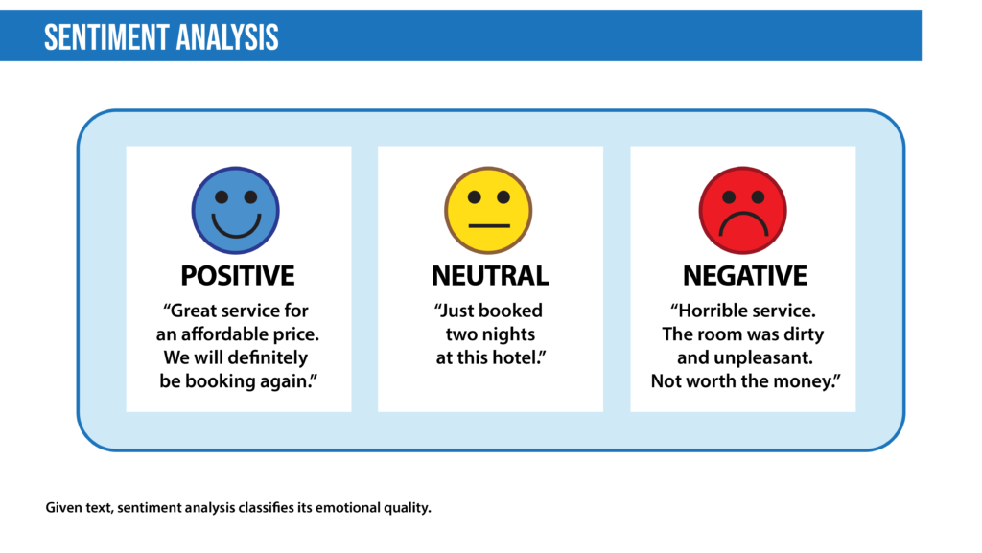
Sentiment analysis
Sentiment analysis is the process of classifying the emotional intent of text. Generally, the input to a sentiment classification model is a piece of text, and the output is the probability that the sentiment expressed is positive, negative, or neutral. Typically, this probability is based on either hand-generated features, word n-grams, TF-IDF features, or using deep learning models to capture sequential long- and short-term dependencies. Sentiment analysis is used to classify customer reviews on various online platforms as well as for niche applications like identifying signs of mental illness in online comments.

Slide 7
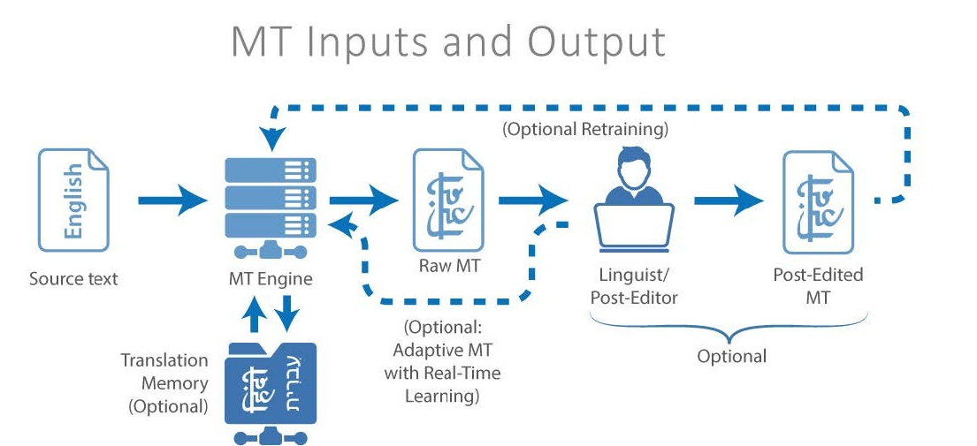
Machine translation
Machine translation automates translation between different languages. The input to such a model is text in a specified source language, and the output is the text in a specified target language. Google Translate is perhaps the most famous mainstream application. Such models are used to improve communication between people on social-media platforms such as Facebook or Skype. Effective approaches to machine translation can distinguish between words with similar meanings. Some systems also perform language identification; that is, classifying text as being in one language or another.

Slide 8
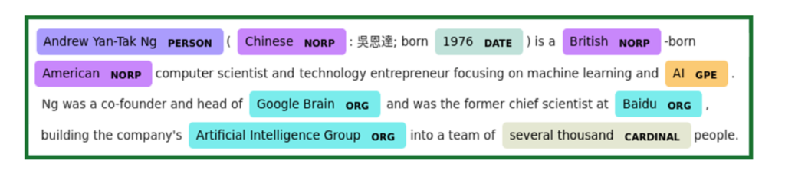
Named entity recognition
Named entity recognition aims to extract entities in a piece of text into predefined categories such as personal names, organizations, locations, and quantities. The input to such a model is generally text, and the output is the various named entities along with their start and end positions. Named entity recognition is useful in applications such as summarizing news articles and combating disinformation. For example, here is what a named entity recognition model could provide:

Slide 9
How Does Natural Language Processing (NLP) Work?
NLP models work by finding relationships between the constituent parts of language — for example, the letters, words, and sentences found in a text dataset. NLP architectures use various methods for data preprocessing, feature extraction, and modeling. Some of these processes are:
Notes:
Now bviously I cannot explain the structure of the NN, but I will explain the various processes used before the training , during the training.

Slide 10
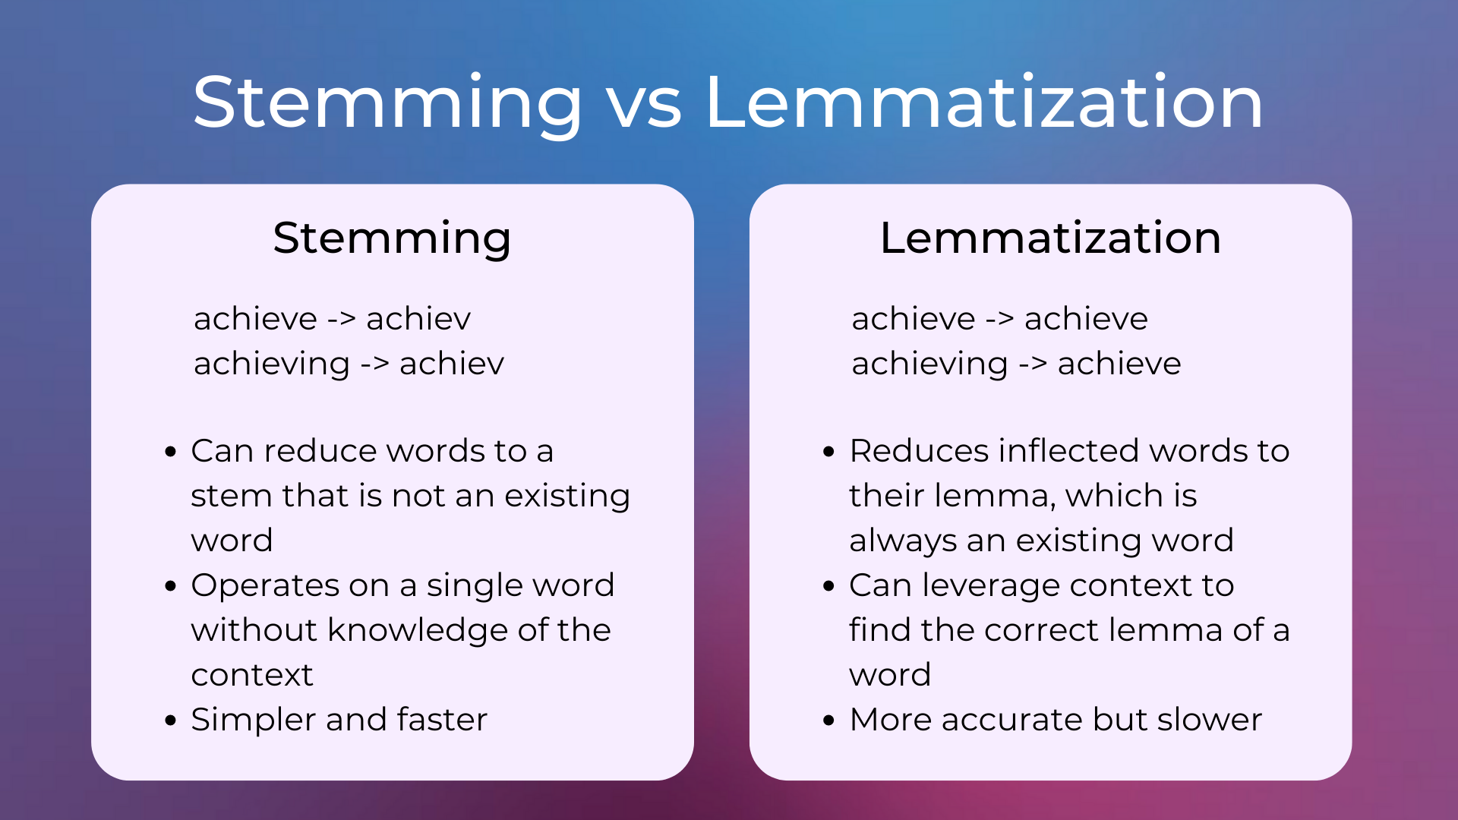
Data preprocessing
Before a model processes text for a specific task, the text often needs to be preprocessed to improve model performance or to turn words and characters into a format the model can understand. Data-centric AI is a growing movement that prioritizes data preprocessing. Various techniques may be used in this data preprocessing
Stemming and lemmatization: Stemming is an informal process of converting words to their base forms using heuristic rules. For example, “university,” “universities,” and “university’s” might all be mapped to the base univers. (One limitation in this approach is that “universe” may also be mapped to univers, even though universe and university don’t have a close semantic relationship.) Lemmatization is a more formal way to find roots by analyzing a word’s morphology using vocabulary from a dictionary. Stemming and lemmatization are provided by libraries like spaCy and NLTK.
Notes:
Now before the NN to be trained we have to collect the data. No it depends what type of model you are creating for example for simple question answer bot, you can use supervised learinig which has labelled data, and here you may no have to do this step.

Slide 11
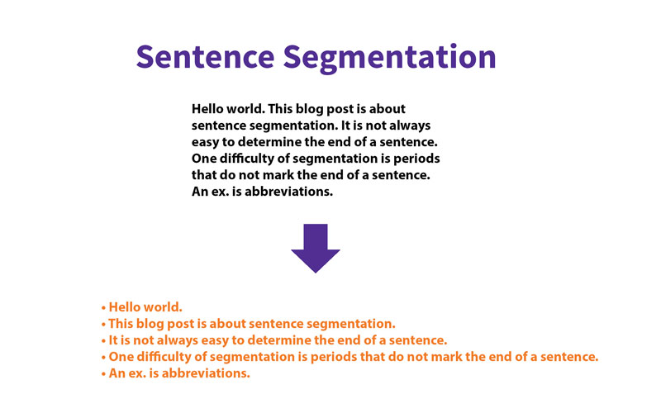
Data preprocessing
Sentence segmentation breaks a large piece of text into linguistically meaningful sentence units. This is obvious in languages like English, where the end of a sentence is marked by a period, but it is still not trivial. A period can be used to mark an abbreviation as well as to terminate a sentence, and in this case, the period should be part of the abbreviation token itself. The process becomes even more complex in languages, such as ancient Chinese, that don’t have a delimiter that marks the end of a sentence.
Notes:
This technique helps in data processing faster and efficient way since we have reduced or breaked the data into smaller chunks

Slide 12
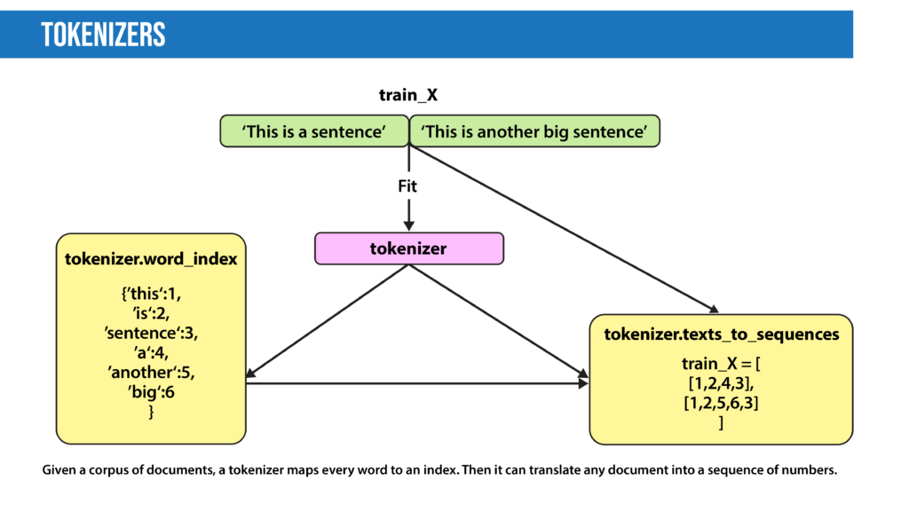
Data preprocessing
Tokenization splits text into individual words and word fragments. The result generally consists of a word index and tokenized text in which words may be represented as numerical tokens for use in various deep learning methods. A method that instructs language models to ignore unimportant tokens can improve efficiency.
Notes:
This helps in storage reduction so less ram is required during training. And also to ignore the common words by eliminating those labelled keys.

Slide 13
Feature extraction
Feature extraction: Most conventional machine-learning techniques work on the features – generally numbers that describe a document in relation to the corpus that contains it – created by either Bag-of-Words, TF-IDF, or generic feature engineering such as document length, word polarity, and metadata (for instance, if the text has associated tags or scores). More recent techniques include Word2Vec, GLoVE, and learning the features during the training process of a neural network.

Slide 14
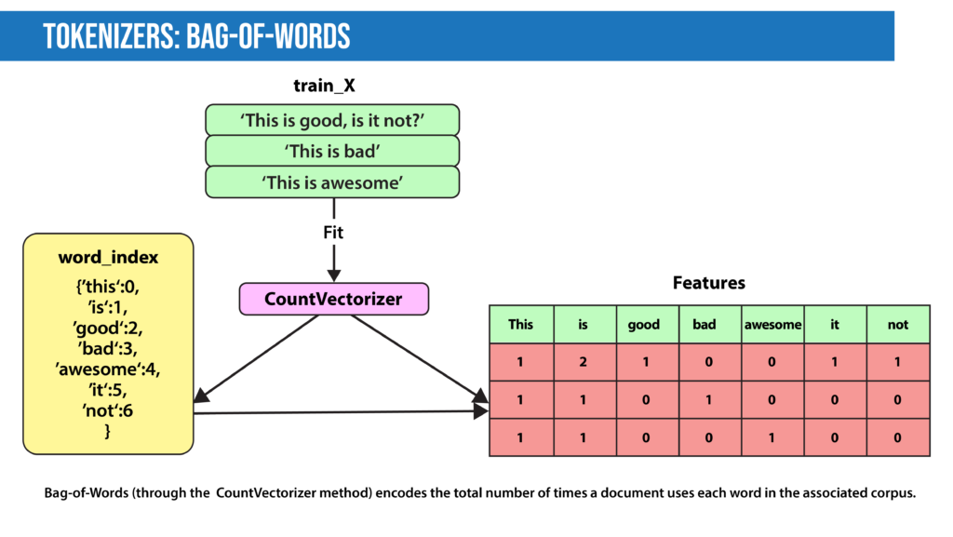
Feature extraction
Bag-of-Words: Bag-of-Words counts the number of times each word or n-gram (combination of n words) appears in a document. For example, the figure shows, the Bag-of-Words model creates a numerical representation of the dataset based on how many of each word in the word_index occur in the document.

Slide 15
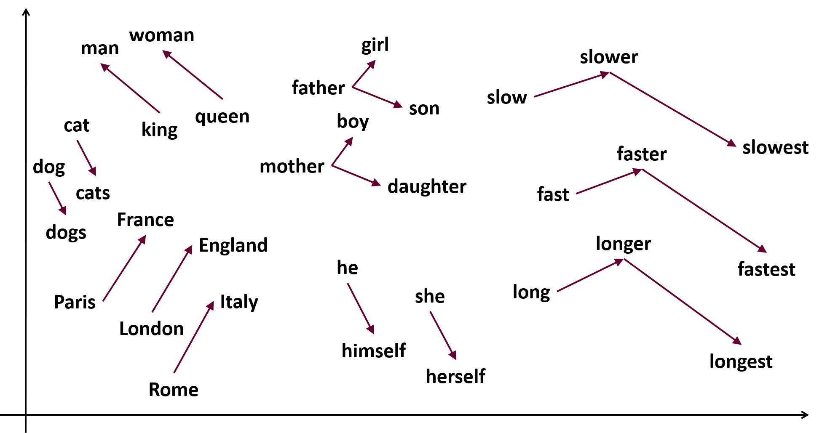
Feature extraction
Word2Vec, introduced in 2013, uses a vanilla neural network to learn high-dimensional word embeddings from raw text. It comes in two variations: Skip-Gram, in which we try to predict surrounding words given a target word, and Continuous Bag-of-Words (CBOW), which tries to predict the target word from surrounding words. After discarding the final layer after training, these models take a word as input and output a word embedding that can be used as an input to many NLP tasks. Embeddings from Word2Vec capture context. If particular words appear in similar contexts, their embeddings will be similar.
Notes:
to find words with similar meaning or to detect patterns in the text, remember this also for the explaination of the GPT

Slide 16
Modeling
After data is preprocessed, it is fed into an NLP architecture that models the data to accomplish a variety of tasks.
Numerical features extracted by the techniques described above can be fed into various models depending on the task at hand. For example, for classification, the output from the TF-IDF vectorizer could be provided to logistic regression, naive Bayes, decision trees, or gradient boosted trees. Or, for named entity recognition, we can use hidden Markov models along with n-grams.
Deep neural networks typically work without using extracted features, although we can still use TF-IDF or Bag-of-Words features as an input.
Language Models: In very basic terms, the objective of a language model is to predict the next word when given a stream of input words. Probabilistic models that use Markov assumption are one example:
P(W_{n})=P(W_{n}|W_{n−1})
Deep learning is also used to create such language models. Deep-learning models take as input a word embedding and, at each time state, return the probability distribution of the next word as the probability for every word in the dictionary. Pre-trained language models learn the structure of a particular language by processing a large corpus, such as Wikipedia. They can then be fine-tuned for a particular task. For instance, BERT has been fine-tuned for tasks ranging from fact-checking to writing headlines.

Slide 17
Top Natural Language Processing (NLP) Techniques
Most of the NLP tasks discussed above can be modeled by a dozen or so general techniques. It’s helpful to think of these techniques in two categories: Traditional machine learning methods and deep learning methods.
Notes:
Now from here onwards, I want you guys to keep like a changing perspective. That is as we move from one type of technique to another you should have different perspective.

Slide 18
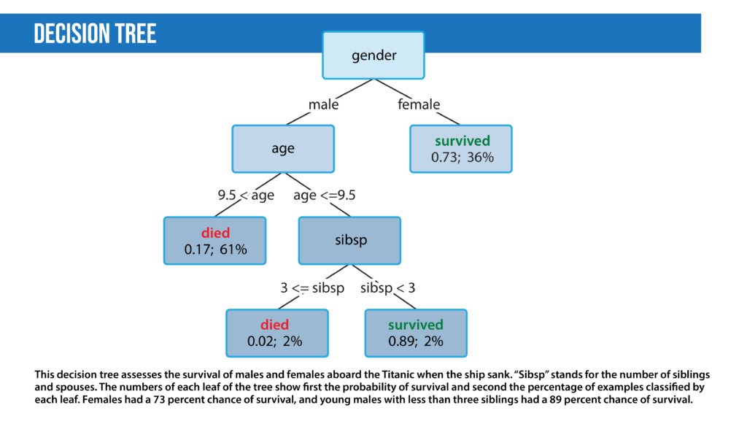
Traditional Machine learning NLP techniques:
Logistic regression is a supervised classification algorithm that aims to predict the probability that an event will occur based on some input. In NLP, logistic regression models can be applied to solve problems such as sentiment analysis, spam detection, and toxicity classification.
Naive Bayes is a supervised classification algorithm that finds the conditional probability distribution P(label | text) using the following Bayes formula:
P(label | text) = P(label) x P(text|label) / P(text)
Decision trees are a class of supervised classification models that split the dataset based on different features to maximize information gain in those splits.

Slide 19
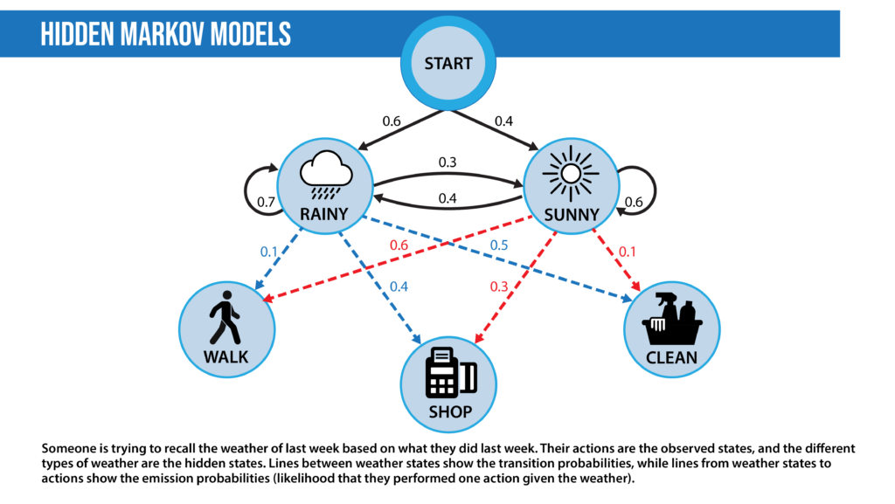
Traditional Machine learning NLP techniques
Hidden Markov models: Markov models are probabilistic models that decide the next state of a system based on the current state. For example, in NLP, we might suggest the next word based on the previous word. We can model this as a Markov model where we might find the transition probabilities of going from word1 to word2, that is, P(word1|word2). Then we can use a product of these transition probabilities to find the probability of a sentence. The hidden Markov model (HMM) is a probabilistic modeling technique that introduces a hidden state to the Markov model. A hidden state is a property of the data that isn’t directly observed. HMMs are used for part-of-speech (POS) tagging where the words of a sentence are the observed states and the POS tags are the hidden states. The HMM adds a concept called emission probability; the probability of an observation given a hidden state. In the prior example, this is the probability of a word, given its POS tag. HMMs assume that this probability can be reversed: Given a sentence, we can calculate the part-of-speech tag from each word based on both how likely a word was to have a certain part-of-speech tag and the probability that a particular part-of-speech tag follows the part-of-speech tag assigned to the previous word. In practice, this is solved using the Viterbi algorithm.

Slide 20
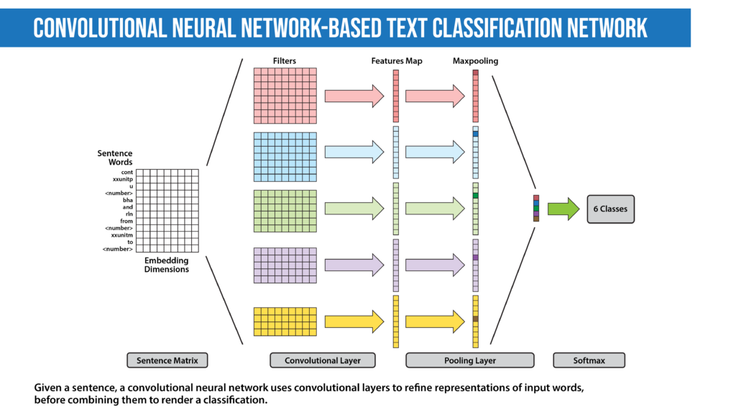
Deep learning NLP Techniques
Convolutional Neural Network (CNN): The idea of using a CNN to classify text was first presented in the paper “Convolutional Neural Networks for Sentence Classification” by Yoon Kim. The central intuition is to see a document as an image. However, instead of pixels, the input is sentences or documents represented as a matrix of words.

Slide 21
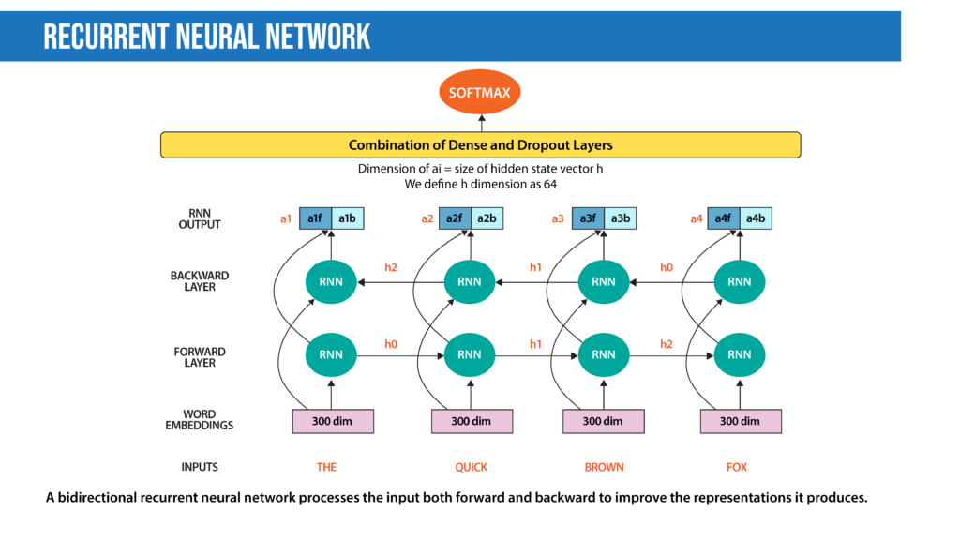
Deep learning NLP Techniques
Recurrent Neural Network (RNN): Many techniques for text classification that use deep learning process words in close proximity using n-grams or a window (CNNs). They can see “New York” as a single instance. However, they can’t capture the context provided by a particular text sequence. They don’t learn the sequential structure of the data, where every word is dependent on the previous word or a word in the previous sentence. RNNs remember previous information using hidden states and connect it to the current task. The architectures known as Gated Recurrent Unit (GRU) and long short-term memory (LSTM) are types of RNNs designed to remember information for an extended period. Moreover, the bidirectional LSTM/GRU keeps contextual information in both directions, which is helpful in text classification. RNNs have also been used to generate mathematical proofs and translate human thoughts into words.

Slide 22
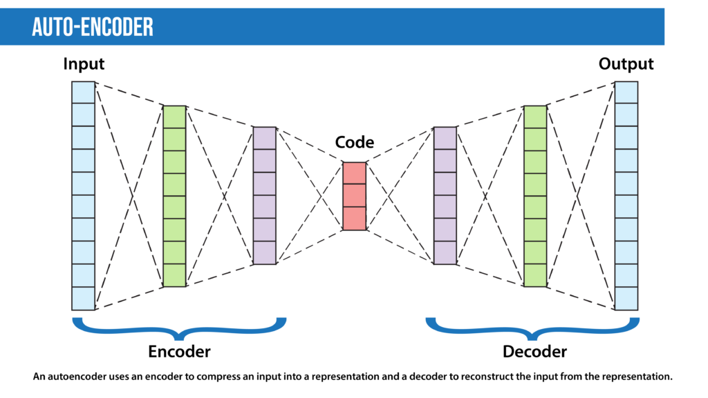
Deep learning NLP Techniques
Autoencoders are deep learning encoder-decoders that approximate a mapping from X to X, i.e., input=output. They first compress the input features into a lower-dimensional representation (sometimes called a latent code, latent vector, or latent representation) and learn to reconstruct the input. The representation vector can be used as input to a separate model, so this technique can be used for dimensionality reduction. Among specialists in many other fields, geneticists have applied autoencoders to spot mutations associated with diseases in amino acid sequences.

Slide 23
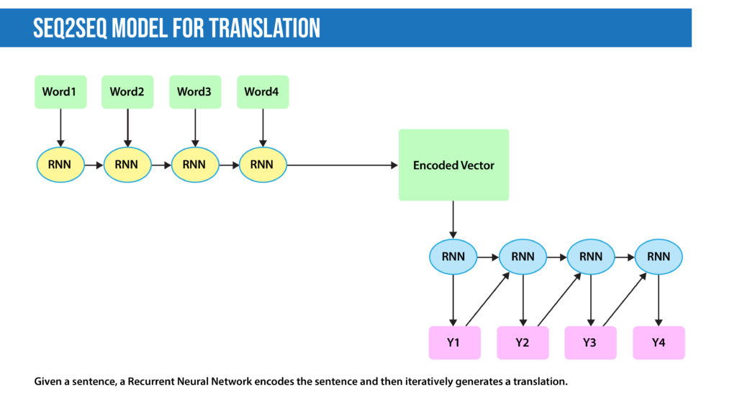
Deep learning NLP Techniques
Encoder-decoder sequence-to-sequence: The encoder-decoder seq2seq architecture is an adaptation to autoencoders specialized for translation, summarization, and similar tasks. The encoder encapsulates the information in a text into an encoded vector. Unlike an autoencoder, instead of reconstructing the input from the encoded vector, the decoder’s task is to generate a different desired output, like a translation or summary.

Slide 24
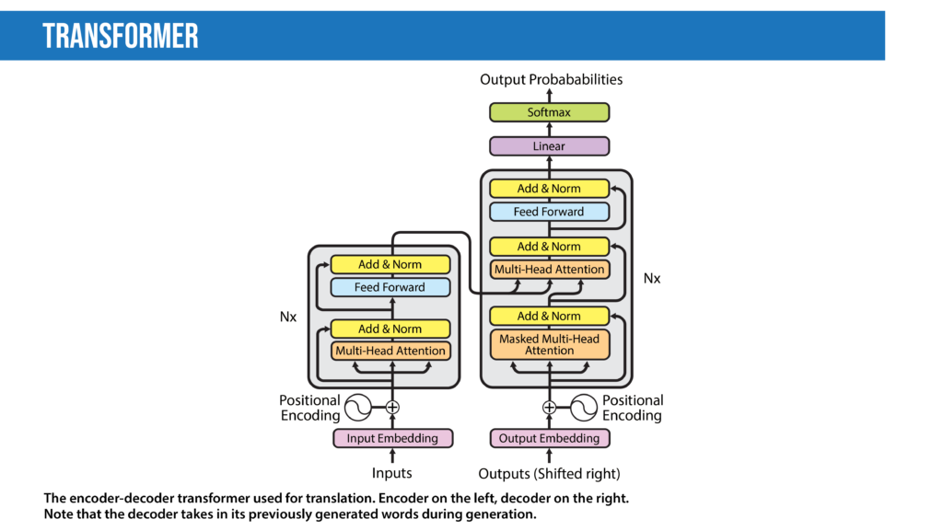
Deep learning NLP Techniques
Transformers: The transformer, a model architecture first described in the 2017 paper “Attention Is All You Need” (Vaswani, Shazeer, Parmar, et al.), forgoes recurrence and instead relies entirely on a self-attention mechanism to draw global dependencies between input and output. Since this mechanism processes all words at once (instead of one at a time) that decreases training speed and inference cost compared to RNNs, especially since it is parallelizable. The transformer architecture has revolutionized NLP in recent years, leading to models including BLOOM, Jurassic-X, and Turing-NLG. It has also been successfully applied to a variety of different vision tasks, including making 3D images.
Notes:
Semi supervised learning : pretrained on a large unlabelled data in unsupervised manner, but thenthey are finetune using supervised techinques to get to the better result. What is dirrent in this compared to RNN is that this useds Attention mechanism. This mean that instead of finding the probability and attaching the next word, they know the context/meaning of the word to be used, this gives them a good advantage to get human related outputs.

Slide 25
Transformers
The architecture is based on the idea of self-attention, which allows the model to focus on the most relevant parts of the input sequence for a given task. The Transformer consists of an encoder and a decoder, both of which are composed of multiple layers of self-attention and feed-forward neural networks.
The encoder takes the input sequence, such as a sentence, and produces a sequence of hidden representations. Each encoder layer performs self-attention on the previous layer's outputs to identify the most relevant information for the next layer to process.
The decoder takes the output sequence of the encoder and generates a translation or another sequence. The decoder also uses self-attention to focus on relevant parts of the input sequence, but it also incorporates an additional attention mechanism to focus on relevant parts of the encoder outputs.
One of the key features of the Transformer is the use of multi-head attention, which allows the model to attend to different parts of the input sequence in parallel. The model also uses residual connections and layer normalization to help with training and prevent overfitting.
Overall, the Transformer architecture is known for its ability to handle long input sequences and its effectiveness in machine translation and other natural language processing tasks.
Reference : https://youtu.be/kCc8FmEb1nY

Slide 26
Transformers
In the Transformer architecture, the "Add & Norm" block refers to the residual connection followed by layer normalization applied in each sub-layer of the encoder and decoder stacks. This block enables efficient gradient flow during training, helping to alleviate the vanishing gradient problem.
The "positional encoding" in the Transformer architecture is a technique used to inject information about the position of each word into the model. This is important because unlike RNNs, Transformers do not have inherent notions of word order or position. Positional encoding allows the model to distinguish between words with the same token but different positions in the input sequence. In the diagram, the "positional encoding" block refers to the operation of adding the positional encoding vectors to the input embeddings

Slide 27
Transformers
The Multi-Head Attention block is a key component of the Transformer architecture that enables the model to attend to different positions within the input sequence simultaneously. The input to the block consists of three vectors: the query vector, the key vector, and the value vector. These vectors are used to compute the attention scores between each input element and all the other elements, which are then used to compute a weighted sum of the value vectors.
In the Multi-Head Attention block, this process is performed multiple times in parallel, with different sets of learned parameters for each "head". The outputs from the different heads are then concatenated and passed through a linear layer to obtain the final output. This enables the model to attend to different aspects of the input sequence in a more fine-grained way, and has been shown to be effective for a variety of natural language processing tasks.

Slide 28
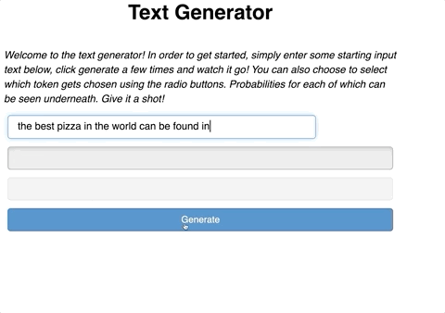
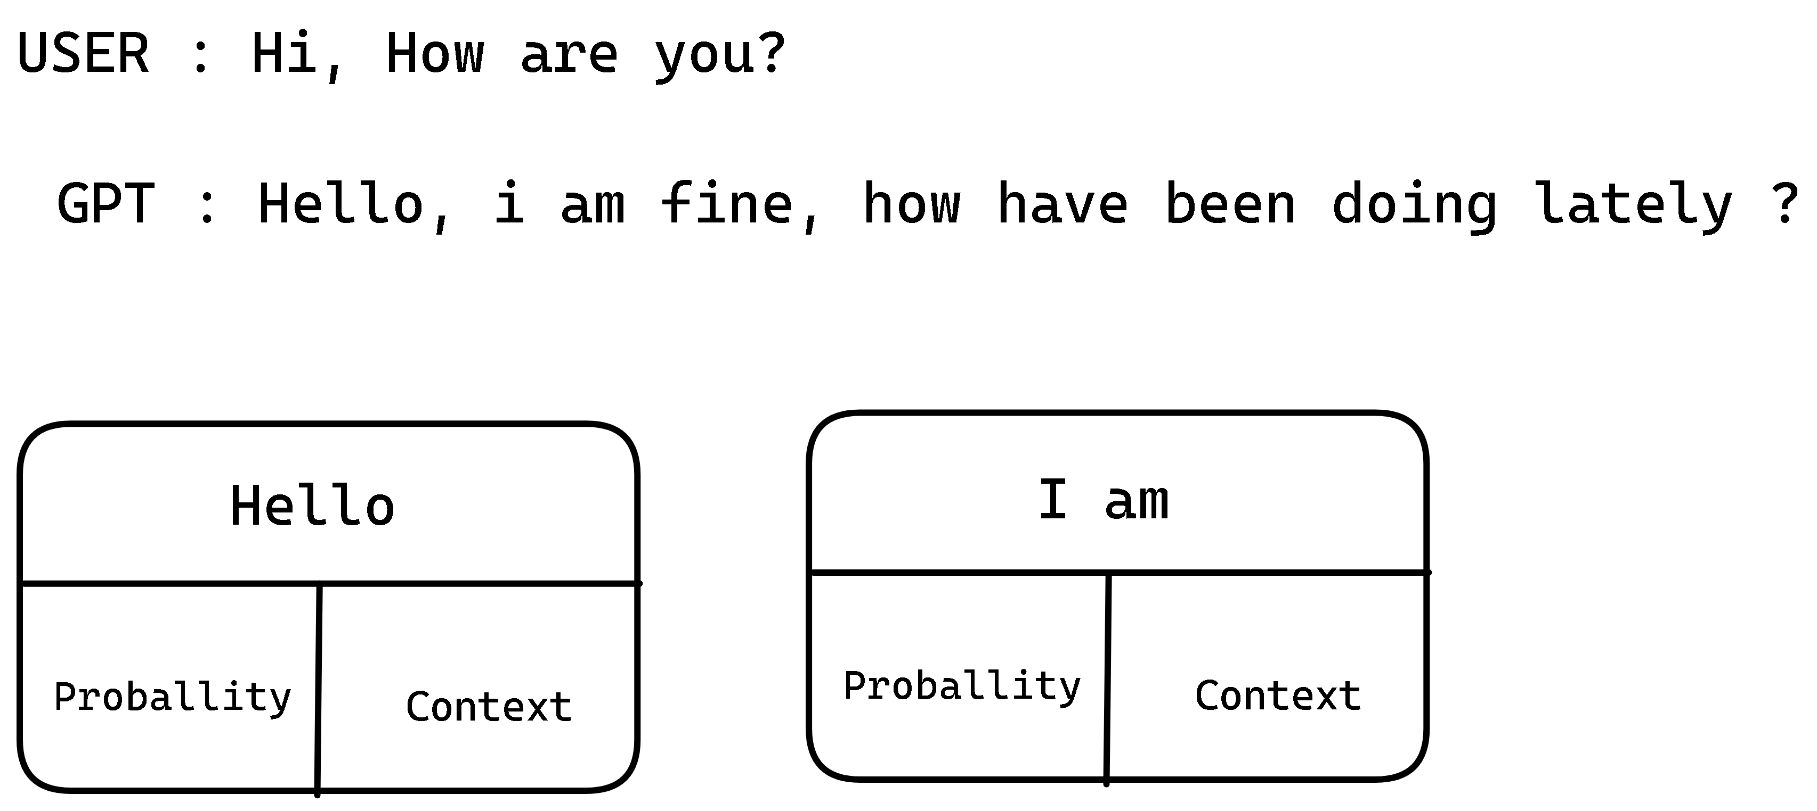
Transformers

Slide 29
FIve Important Natural Language Processing (NLP) Models

Slide 30
Eliza
Eliza is a natural language processing program developed in the mid-1960s by Joseph Weizenbaum. Unlike modern language models such as GPT-3, Eliza was a rule-based chatbot that aimed to simulate a psychotherapist in a text-based conversation.
Eliza did not have any training data or parameters, but instead relied on a set of pattern-matching rules to generate responses. The program would examine the user's input, identify keywords or phrases, and then use a set of pre-defined rules to generate a response that would mimic the language used by a psychotherapist.
For example, if the user said "I'm feeling sad today", Eliza might respond with "Why do you think you're feeling sad?" The program would examine the user's input and use a rule that matched the keywords "feeling" and "sad" to generate a response.
Eliza did not use any activation functions or hidden layers, as it was a rule-based program. However, it was a pioneering effort in the field of natural language processing and paved the way for more advanced language models that followed.

Slide 31
Tay
Tay was a chatbot that Microsoft launched in 2016. It was supposed to tweet like a teen and learn from conversations with real users on Twitter. The bot adopted phrases from users who tweeted sexist and racist comments, and Microsoft deactivated it not long afterward. Tay illustrates some points made by the “Stochastic Parrots” paper, particularly the danger of not debiasing data.
The Tay model was trained using a large dataset of public tweets from Twitter. The dataset was preprocessed to remove irrelevant or offensive content, but the overall goal was to teach the model to engage in conversation in a way that mimicked the language and behavior of Twitter users.
The Tay model used a rectified linear unit (ReLU) activation function. This function is commonly used in neural networks to introduce nonlinearity and enable the model to learn more complex relationships between the input and output.
The exact architecture of the Tay model is not publicly available, but it is known to be a deep convolutional neural network with multiple layers. It is likely that the model contains several hidden layers, each with hundreds or thousands of neurons, which allow it to learn complex patterns and relationships in the input data.

Slide 32
BERT
The original BERT model has two versions: BERT Base and BERT Large, with 110 million and 340 million parameters, respectively. Later, several larger versions have been introduced, including BERT Large with 355 million parameters and BERT Huge with 1.5 billion parameters.
The input dataset used for training BERT is a combination of BookCorpus and English Wikipedia. The BookCorpus is a collection of over 11,000 books of various genres, while the English Wikipedia is a vast encyclopedia containing articles on various topics.
The activation function used in BERT is the GELU (Gaussian Error Linear Unit) activation function, which is a smooth approximation of the rectified linear unit (ReLU) function.
BERT has 12 or 24 transformer encoder layers depending on whether it is the base or large version, respectively. Each transformer encoder layer has a fixed number of neurons, which is determined by the model's hidden size hyperparameter. For example, the BERT Base model has a hidden size of 768, so each transformer encoder layer in the BERT Base model has 768 neurons.

Slide 33
GPT - 3
Generative Pre-Trained Transformer 3 (GPT-3) is a 175 billion parameter model that can write original prose with human-equivalent fluency in response to an input prompt. The model is based on the transformer architecture. The previous version, GPT-2, is open source. Microsoft acquired an exclusive license to access GPT-3’s underlying model from its developer OpenAI, but other users can interact with it via an application programming interface (API). Several groups including EleutherAI and Meta have released open source interpretations of GPT-3.
The input dataset for GPT-3 was a large corpus of text, consisting of a diverse range of sources such as books, articles, and websites. The model was trained to predict the next word or sequence of words in a given piece of text, based on the context of the preceding words.
GPT-3 uses the GELU (Gaussian Error Linear Units) activation function in its neural network. This activation function is similar to the popular ReLU (Rectified Linear Unit) activation function, but with certain advantages such as being smoother and having a mean of zero.
GPT-3 contains 96 layers in its neural network, each of which has 1,536 neurons, for a total of around 175 billion parameters. The number of neurons in each layer can vary depending on the architecture of the neural network, but in general, deeper models tend to have more layers and more neurons to allow for greater complexity and accuracy.

Slide 34
Lamda
LaMDA is a language model that is designed to handle conversational interactions between humans and AI systems. It is trained on a large amount of text data and is capable of generating coherent and informative responses to user inputs.
Similar to GPT-3, LaMDA also uses a large number of parameters to achieve its performance. However, the exact number of parameters in LaMDA is not publicly disclosed by Google.
The training dataset used for LaMDA is not publicly available, but it is likely that Google used a wide variety of text sources to train the model, including books, articles, and online content.
The activation function used in LaMDA is also not publicly disclosed by Google, but it is likely to be a standard non-linear activation function such as ReLU (Rectified Linear Unit) or sigmoid.
The exact number of hidden layers and neurons in LaMDA are also not publicly disclosed by Google, but it is believed to use a transformer-based architecture similar to GPT-3. This architecture typically includes multiple layers of self-attention mechanisms and feed-forward neural networks.

Slide 35
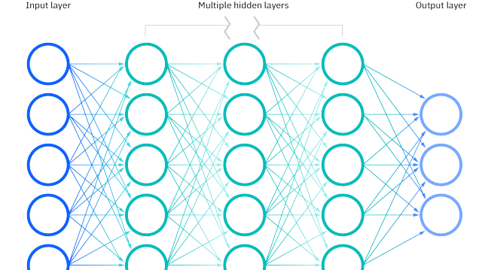
Demonstration of Rule Based Model
Demonstration of Rule Based Model

Slide 36
Working of the model
User : hi, how are you doing?
ChatBot : i'm fine. how about yourself?
User : i've been good
ChatBot : i understand. rain does make it smell cleaner
User : There is not raining outside!
ChatBot : the sky looks so clean after it rains. i love it.
User : Its extremely hot outside
ChatBot : will it be good beach weather?
User : Yeah, of course, it’s a great time to go on beach
ChatBot : i stayed home because i wasn't feeling well.
User : So what is your name?
ChatBot : As a AI chatbot I don’t have a name.
User :

Slide 37
Demonstration of Generative Model
Pretrained Models available at HuggingFace.com

Slide 38
Testing facebook/blenderbot-400M-distill
User : Hello, How are you?
I'm doing well, how are you doing? I just got back from the grocery store.</s>
User : What did you brought from the store?
I bought a bunch of stuff for my kids. They are going to be so happy.</s>
User : Ohh, that's cool, did you brought them chocolates ?
No, I didn't think of that. I should have though. Maybe I'll do that next time.</s>
User : Yes, you should, children likes chocolates
Chocolate is one of my favorite things to eat, especially when it is sweetened with sugar or high fructose corn syrup.</s>
User : Anyways, do you know John Wick ?
Yes, he was an American singer, songwriter, actor, and record producer.</s>
User : Ohh, i think you are talking about different person, i was talking about the movie, have watched that movie ?
No, I haven't seen the movie. I know it's based on a book, but I've never read it.</s>
User : Okay, i didnt knew that, but i am sure you will love it, its the best action movie
I can't wait to see it, it's been a long time since I've seen a good action movie.</s>
User :
Notes:
Why i am showing this is because this code is not easily availableon the internet and I had lot of trouble in findind this initially.

Slide 39
Testing google/flan-t5-bas
User : Okay, good! but i was actually talking about Natural Language Programming
Okay, good! but i was actually talking about Natural Language Programming.
User : Why did you repeated my statement ?
I was referring to you.
User : No, thats not true
no, thats not true.
User : don't repeat me
don't repeat me
User : do you know programming?
yes
User : What programming languages do you know ?
javascript
User : cool
cool
User : Hello, how have you been?
I'm fine, I'm fine.
User : That's great, and what you were doing?
I was doing a little shopping.
User : what did you brought?
a hat
User : i too love hats
hats are my favorite thing
User : okay, do you know anything about NLP?
yes
User : what is NLP ?
nonlinear programming
Notes:
Why i am showing this is because this code is not easily availableon the internet and I had lot of trouble in findind this initially.

Slide 40
Text Generation by GPT 2 - Offline
User : Sleep is very import for humans
GPT 2 :
Sleep is very import for humans, which is true of people of a certain age and condition where there is less or no risk.
"My goal with all of our diets is to reduce risk by helping us develop as healthy as possible as we can. People who have a history of metabolic problems who're obese are in a strong position not only to become healthier but also to be successful in their weight loss."
While many people around the world consume too much of natural sugars such as sugars in their diets, according to Dr Gavan H. Mehta, Senior Consultant with the National Low Carb and Fiber Diet Group at Diabetes UK, it could result in people being more likely to experience metabolic problems, such as diabetes, metabolic syndrome, high blood pressure, high triglyceride levels, and other chronic health problems. This is particularly apparent to those living in a low-carb diet, which also includes saturated fats.
She advises people to limit their intakes of certain types of carbohydrates because it can increase the risk of cardiovascular disease. "By the time too much of our food comes in its way people would become dehydrated and this could lead to a metabolic problem," she explains.
Other diet factors include how much you eat (including sweets) or how much you consume from a variety of sources – such as a lot of fruits, vegetables, and high-energy drinks. A high-fat diet is also considered healthy and can lead to weight regain, she says.
This lack of weight loss may be why a variety of diets and types of sweets are generally found in diet, while most of the refined sugars in natural sugars may be found in fruits and vegetables – a common dietary pattern that is also high in sugars.
What are sugars?
Synthetic sugars – such as sucrose and saccharide – have been around since ancient times and are used to produce energy from sugars. This allows them to make energy from fatty acids to produce energy from carbohydrate to produce energy from fat to produce calories. Sugars are considered "good' for health because they can help you to burn fat efficiently and are often found in fruits, fruits and vegetables.
However, sugars are also found naturally in food, including grains such as wheat and barley, beans, nuts and seeds, fish, fruits and vegetables, and spices, according to Dr Mehta. The glycemic index of healthy dieters includes a range of dietary carbohydrates, such as low
Notes:
Now, why to someone will want to run the GPT ML models locally?
- Incase of absence of internet
- For privacy issues
- MOST IMPORTANT : To generate much more text than what the free ChatGPT service can provide and also may be with the paid service too.

Slide 41
Apple keeps doctor away if he says it's not a good idea to have another child
The family had five kids, as his parents had three.
Sydney's mother, Tristana, said she was shocked.

Slide 42
"We've made incredible strides in generative AI, unlocking remarkable creative potential. Yet, the elusive realm of consciousness remains beyond its grasp. Let us marvel at our achievements in AI while acknowledging that true consciousness shall forever elude its reach.“
- Atmanand Gauns

Slide 43
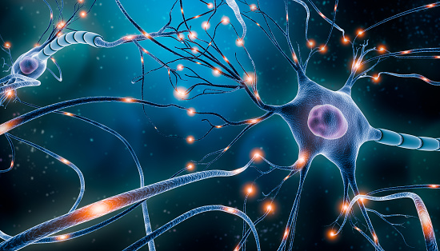
Thank You
WhatsApp : 9960483277
LinkedIN : Atmanand Gauns

